Slide 1
Foursquare Battle of Delhi, India 2020
May 27, 2020

Slide 2
Introduction
Leverage Foursquare locations data to explore venues in Delhi, India.
Find insights of most popular venues in sub-parts of Delhi.
Delhi's 2020 population is now estimated at 30,290,936. It covers a large area, totaling around 1,484 square kilometers. The city has a population density of 20,412 people per square km which is one of the highest in the world.
Using tools learnt in coursera’s IBM Data Science Professional Certificate will help explore the same.

Slide 3
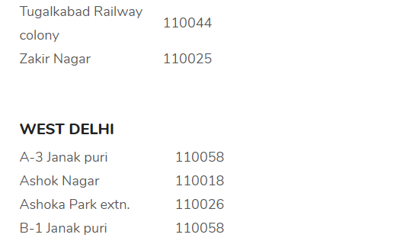
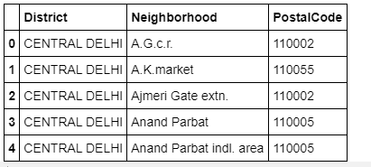
Data
An informative blogpost mentions all the “Postal Codes” along with “Districts” of Delhi https://www.whatsuplife.in/delhi/blog/zip-pin-postal-code-pincodes-delhi. This blogpost webpage was scrapped to extract required data.
BeautifulSoup, python

Slide 4
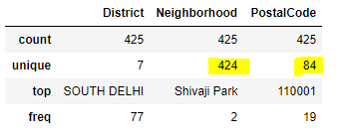
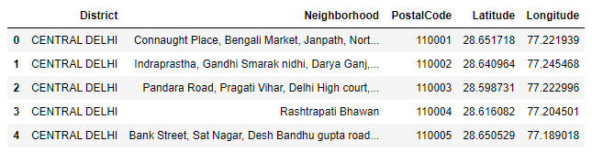
Data
Data has postal codes with multiple neighborhoods, which are contributing to multiple rows. Merge these and also get the corresponding latitudes and longitudes
Python data frames, nominatim for lat, lon

Slide 5
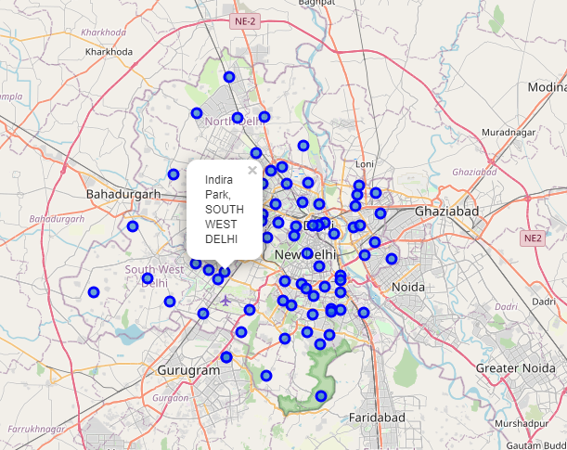
Data
Neighborhoods and Postal Codes on Delhi Map

Slide 6
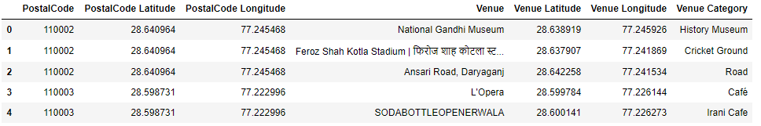
Exploration
Used foursquare venues explore API - https://api.foursquare.com/v2/venues/explore to fetch the top 100 venues corresponding to each postal code.
Number of venues fetched for 84 Postal Codes were 409 which on an average is less than five venues per postal code
There are 99 unique categories for 84 postal codes from the foursquare data

Slide 7
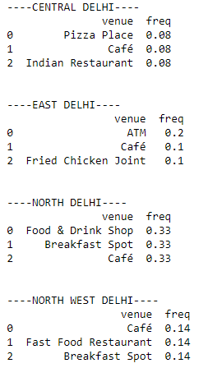
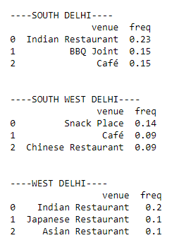
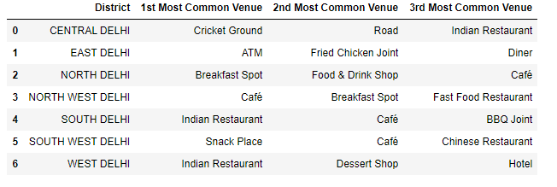
Exploration
Using one-hot encoding, top three venues were calculated.
As you can see below- Central Delhi, North Delhi and North West Delhi top three venues have the same frequency, therefore the results are ambiguous.
This proves the Foursquare API does not have enough "good" data for Delhi to perform analysis.

Slide 8
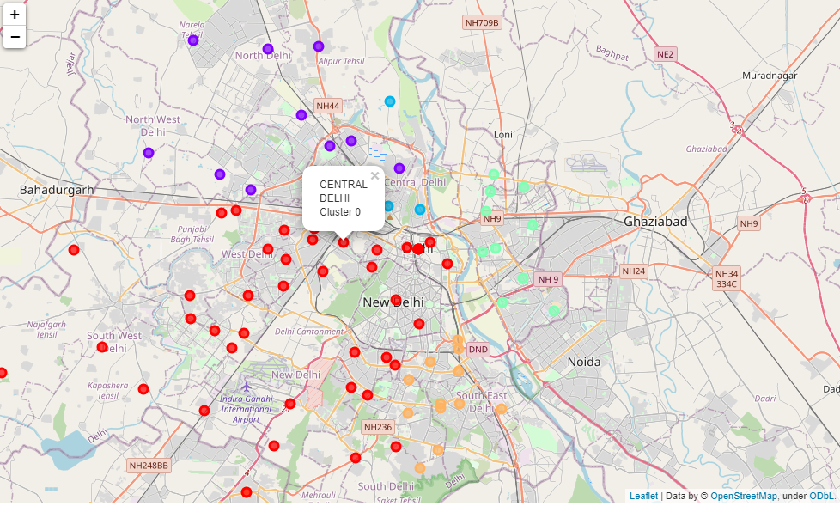
Exploration
K-Means clustering with K=5

Slide 9
Conclusion
Using foursquare API data, I tried to explore different postal codes of Delhi, but the data was very limited, therefore I switched to districts and analyzed the venues available. During analysis of top venues in district, I found out the data is ambiguous also which can be seen from Central Delhi, North Delhi and North West Delhi top three venues have the same frequency, therefore the results are ambiguous.
Lesson learnt
This project is a very good reference and start point for me to further pursue exploration of Delhi, India from other data sources like google places API, and may be some local places providers.

